Slide 1
NETWORK INFORMATION SECURITY
LAB LECTURE 1
LC: Ms. Shiza Riaz Memon

Slide 2
SECURITY GOALS
CIA TRIAD
Confidentiality= Authorized Access only
Integrity=Accuracy of data
Availability= Resources as requested should always be available. Key feature of Distributed Computing.
Ex: Denial of Service Attack
If any of these goals are hampered, Information security is compromised.

Slide 3
Elements of Information Security
Physical Elements=Camera, Guards, R-zone, Downloading, Access Rights etc
System Elements=Antivirus, disable USB ports, malicious Software Detection
Process Elements= Authorized User, Access Control, S/W details, Log entry

Slide 4
Security Policy
Regulatory
Advisory
User Policies
Need?
Control Security Risk
Identity Theft
System Fraud
System Misuse Detection

Slide 5
Types of Attacks
Active Attack
Passive Attack

Slide 6
Active Attack | Passive Attack
Modifies the data | Monitors the data
Affects the System | Does not affect the system
Can be easily detected | Cannot be easily detected
Threats to integrity and availability | Threat to confidentiality
Capture physical control over the link | Just observe the transmission
Detection | Prevention

Slide 7
Active Attacks
Masquerade
Relay=Read and write. Induces error bits, noise etc
Denial of Service

Slide 8
Basics of Network Security
Plain text
Cipher text
Encryption
Decryption
Cryptography
Cryptanalyst
Key

Slide 9
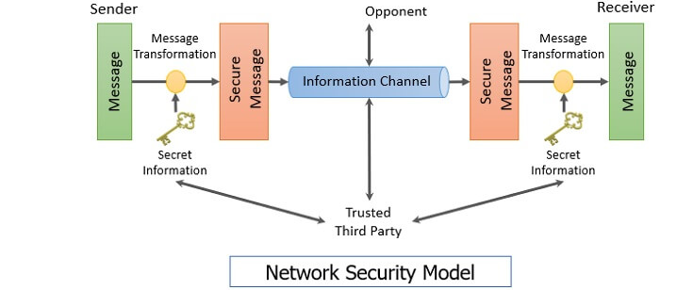
Network Security Model

Slide 10
Symmetric Key Cryptography
Secret key cryptography
Only 1 key is used
Less Complex
Theft of key is an issue

Slide 11
Asymmetric Key Cryptography
Different key for sender and receiver

Slide 12
Symmetric Encryption Techniques
A symmetric encryption is any technique where the same key is used to both encrypt and decrypt the data.
Caeser Cipher
ROT-13
Atbash Cipher
Vigenere Cipher

Slide 13
Substitution Cipher Technique
Mono alphabetic
Poly alphabetic

Slide 14
Substitution Cipher Techniques
Caeser Cipher
C=E(3,P) = (P+3)mod 26
Most used technique
P=D(3,C)=(C-3)mod26
Easy to decrypt
Complexity level is low

Slide 15
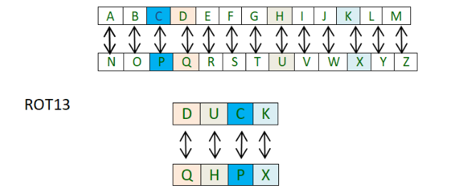
ROT-13
ROT13 cipher(read as – “rotate by 13 places”) is a special case of the Ceaser cipher in which the shift is always 13. So every letter is shifted 13 places to encrypt or to decrypt the message.

Slide 16

Atbash Cipher
Atbash encryption employs a replacement alphabet and its reciprocal, which is a combination of the normal and reverse alphabets (mirrored).

Slide 17

Vigenere Cipher
Vigenere Cipher is a method of encrypting alphabetic text. It uses a simple form of polyalphabetic substitution.
It uses and entire shift key to encrypt a plain text
We want to encrypt a work Versailles with key “CHEESE”

Slide 18
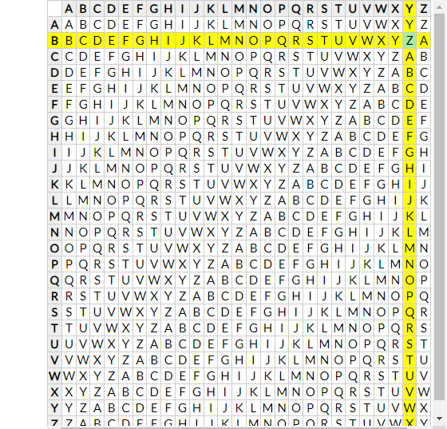

Slide 19
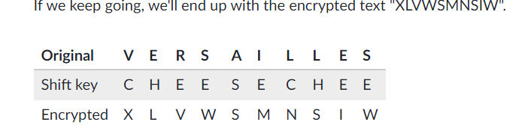
Encrypted Text

